Slide 1
Design & Task-Based Optimization Of A Modular Robot Manipulator Working In A Heavily Constrained Environment
By: Asbjørn Tjensvold
Supervisors: Martin Fodstad Stølen & Daniel Schäle

Slide 2
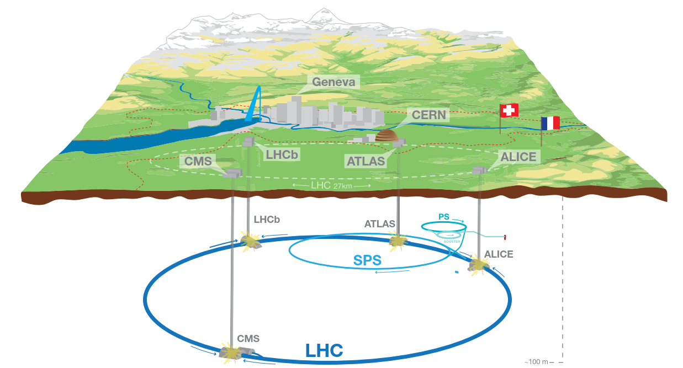
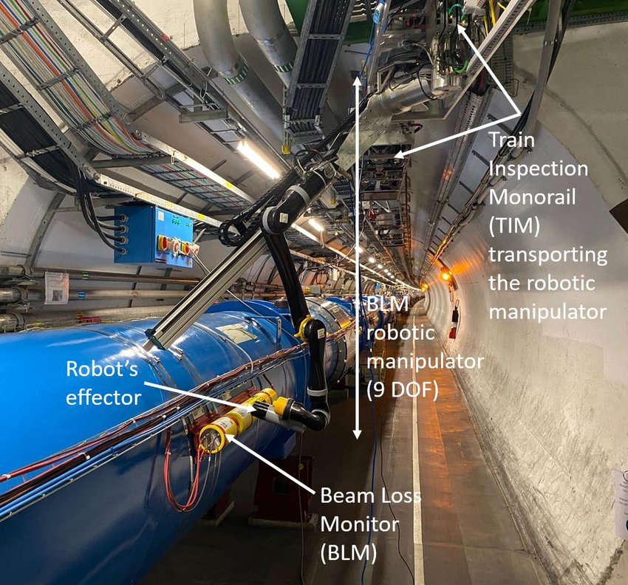
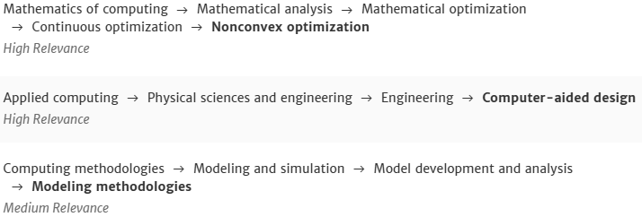
Introduction & Motivation
Research questions:
Is it possible to design a modular robotic arm to meet the specific challenges of the LHC tunnel, eliminating the need for external solutions and without compromising the efficiency of the TIM system?
Is it possible/beneficial to create a modular design for this system?
Is it possible to remove degrees of freedom (DOF) from the design and not lose functionality, thus making the arm lighter?
How do you adequately measure the performance of a robot arm?
In the limited time span of this assignment, is it possible to manufacture a completed prototype or should the focus be on formulating a proof of concept (POC)?
CSS Classification

Slide 3
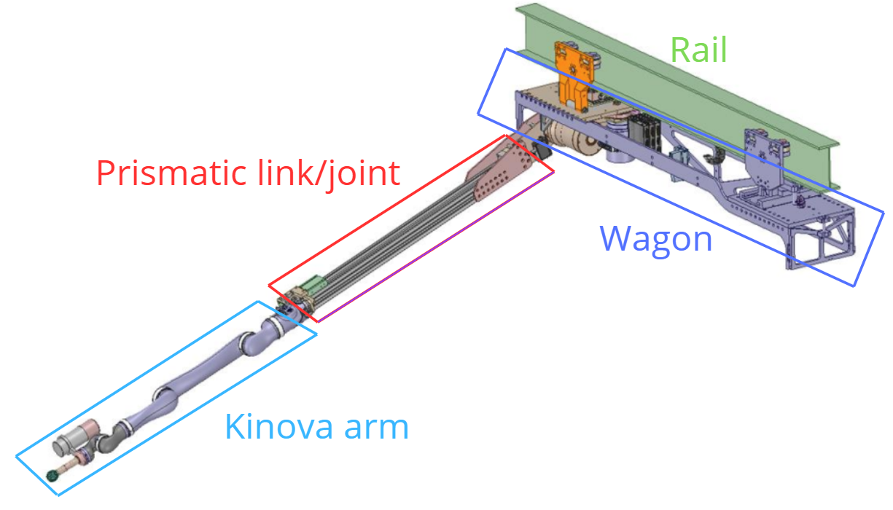
Introduction & Motivation
Issues with current solution:
Overly complicated
End of life for commercial kinova arm
Not specialized for tasks
Benefits of proposed solution:
Modular & Parametric design: Can easily adapt to changing tasks & environment
Simpler maintenance
Optimized for this specific set of tasks
Similar work:
Future Circular Collider(FCC)
GlobDesOpt

Slide 4
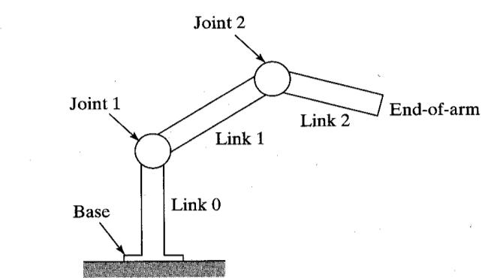
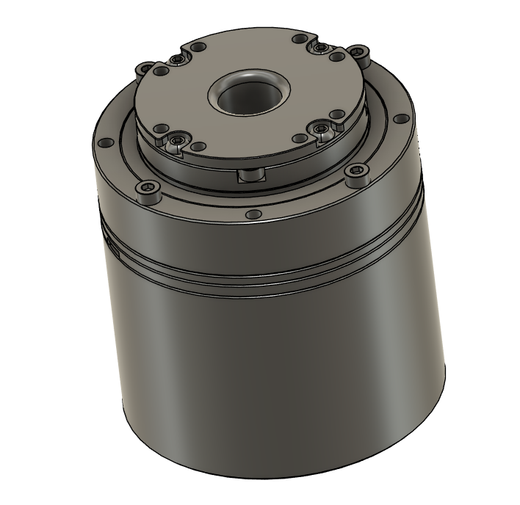
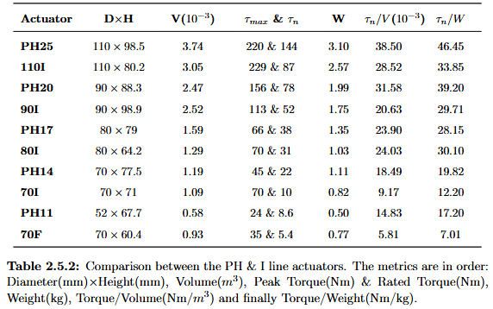
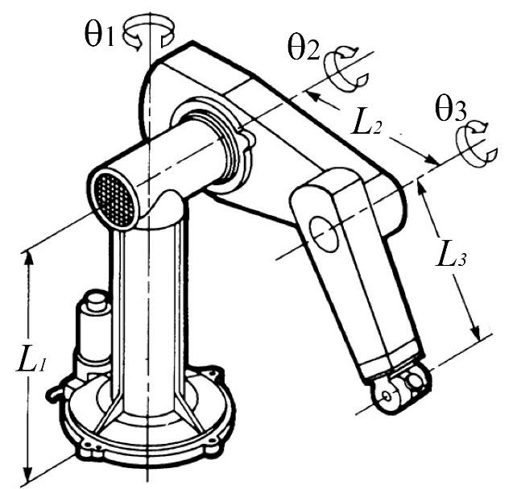
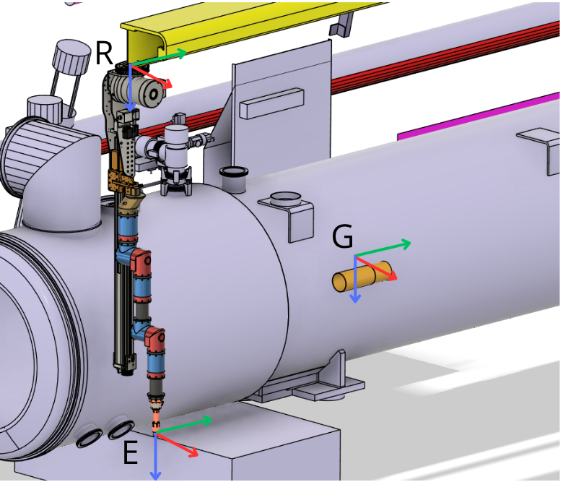
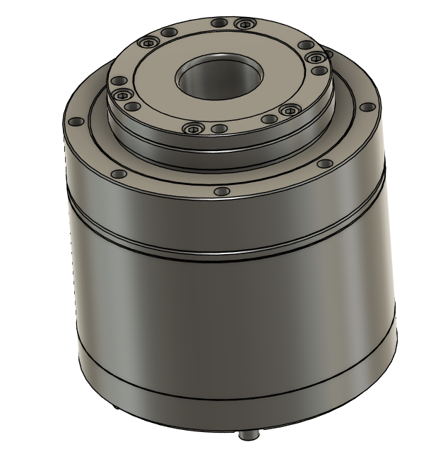
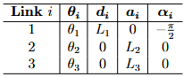
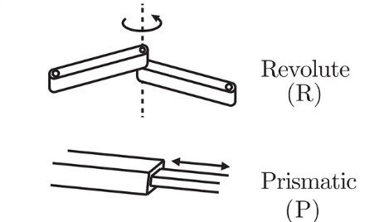
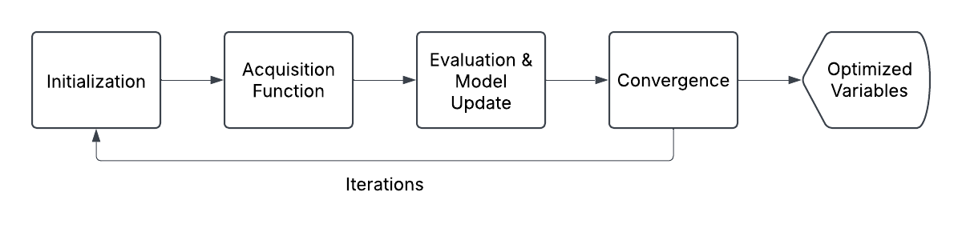
Background
Mechanical design:
Joints & Links
End Effector
Actuator review
Modularity
Mathematical modeling:
Poses
DH Parameters: a, d, α, θ
Bayesian optimization:
Initialization
Acquisition Function
Evaluation & model update
Iterations & Convergence

Slide 5
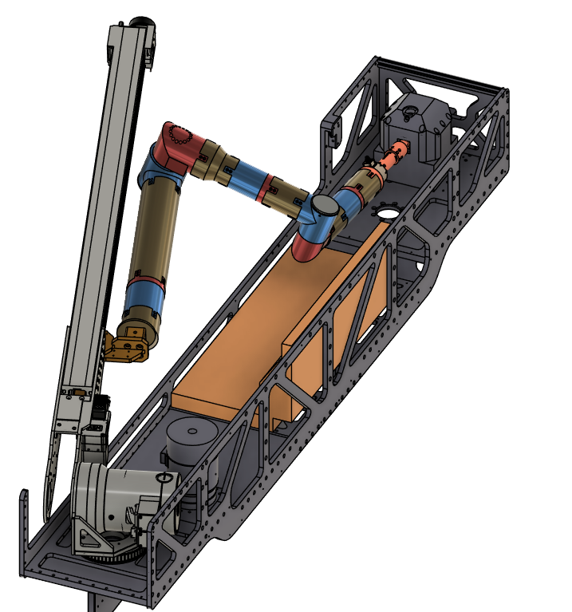
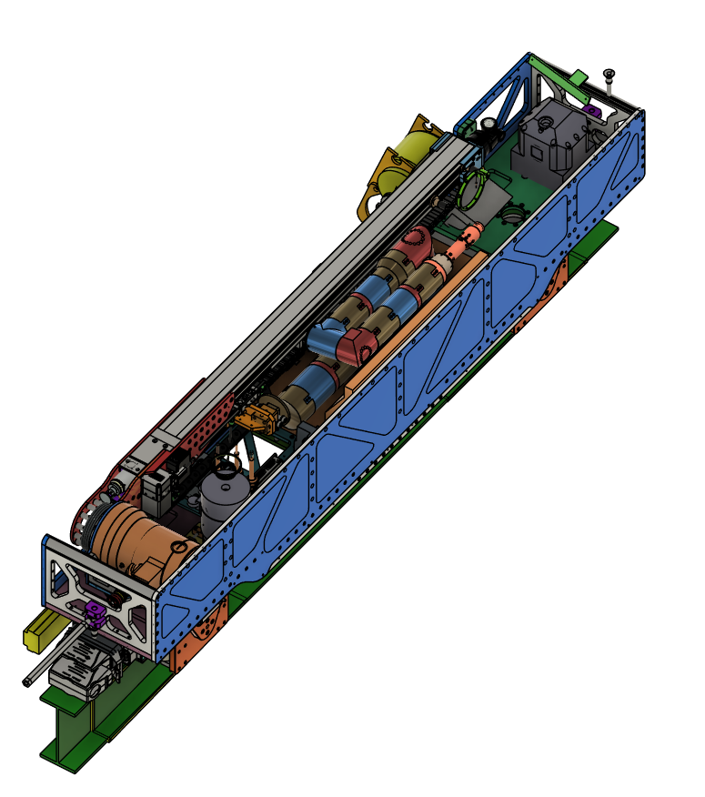
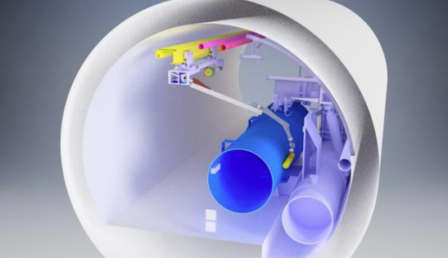
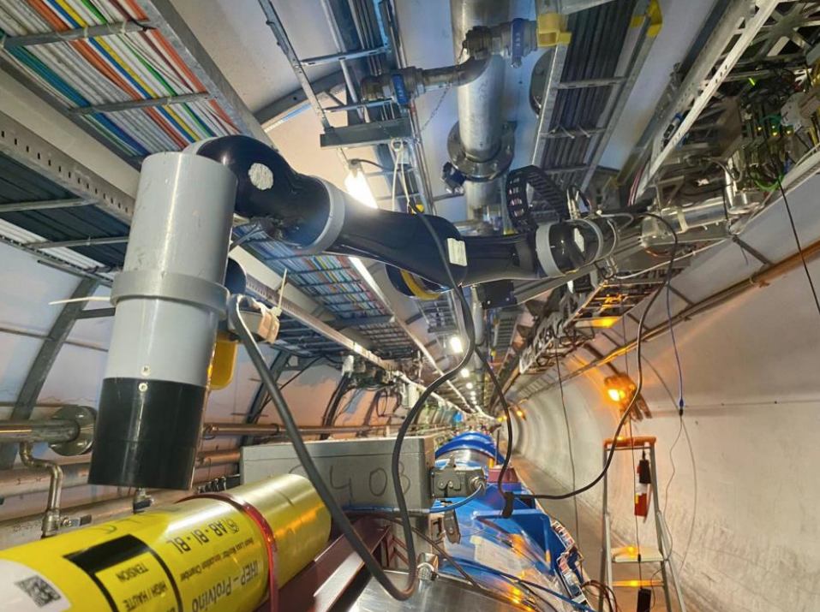
Task Definition
Source Extraction & Folding
Radiation mapping and information gathering

Slide 6
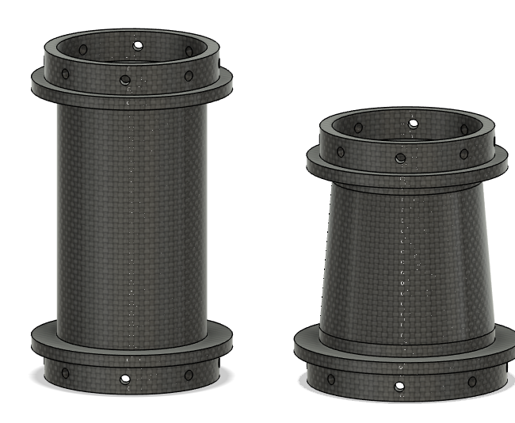
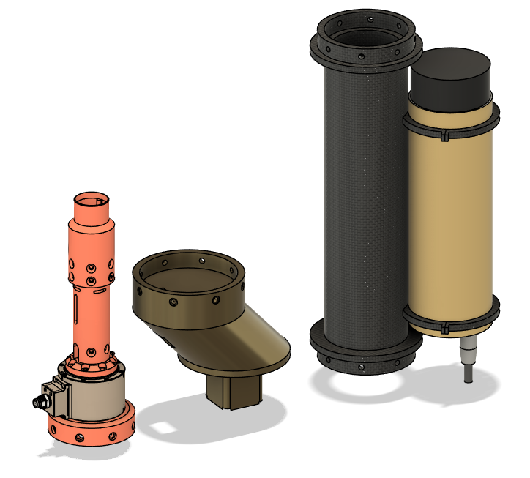
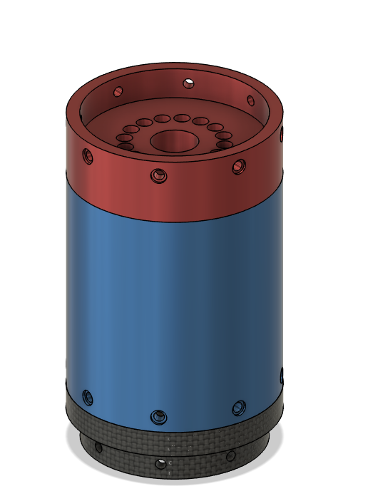
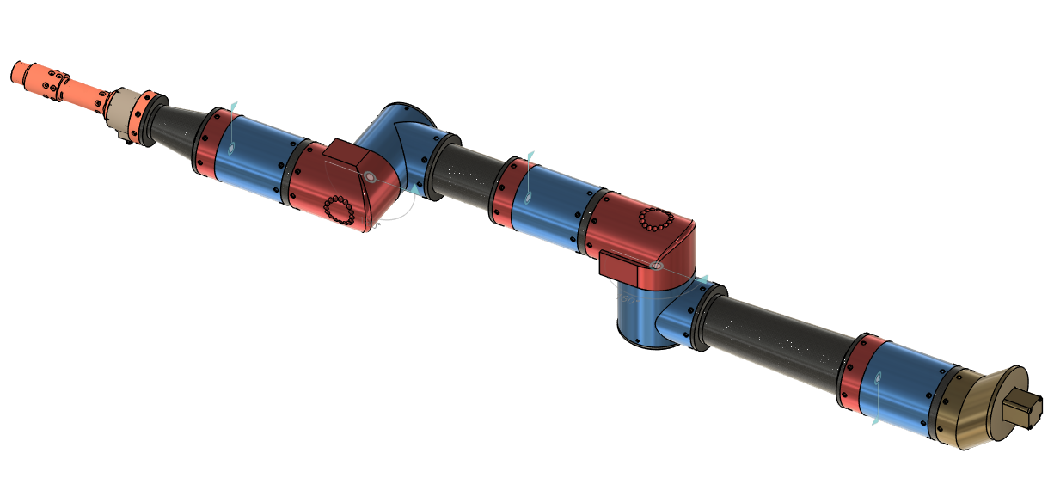
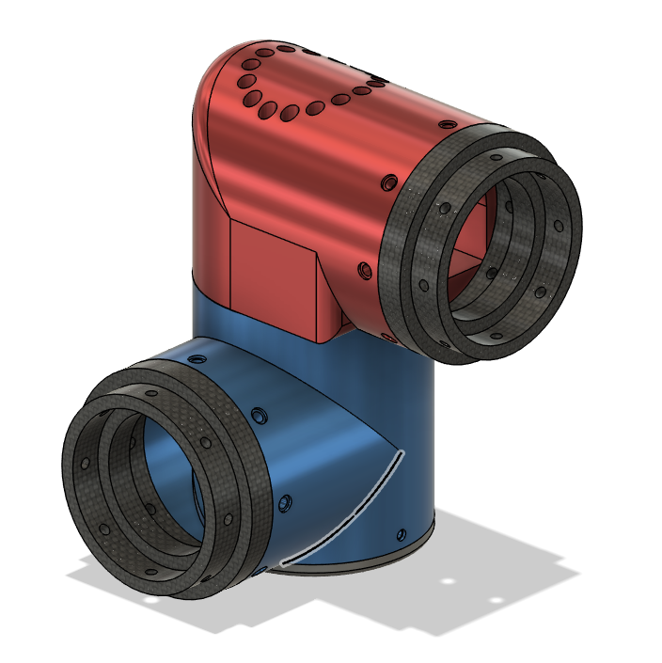
Methodology:Design

Slide 7
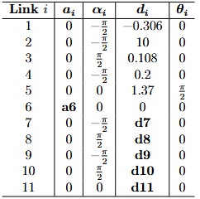
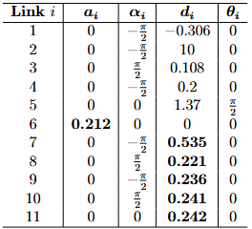
Methodology:Optimization
Assign random values to variables based on specified bounds
Minimize total length(a₆ + d₇₋₁₁)
Perform path planning with collision avoidance
Evaluate performance(reachability)

Slide 8
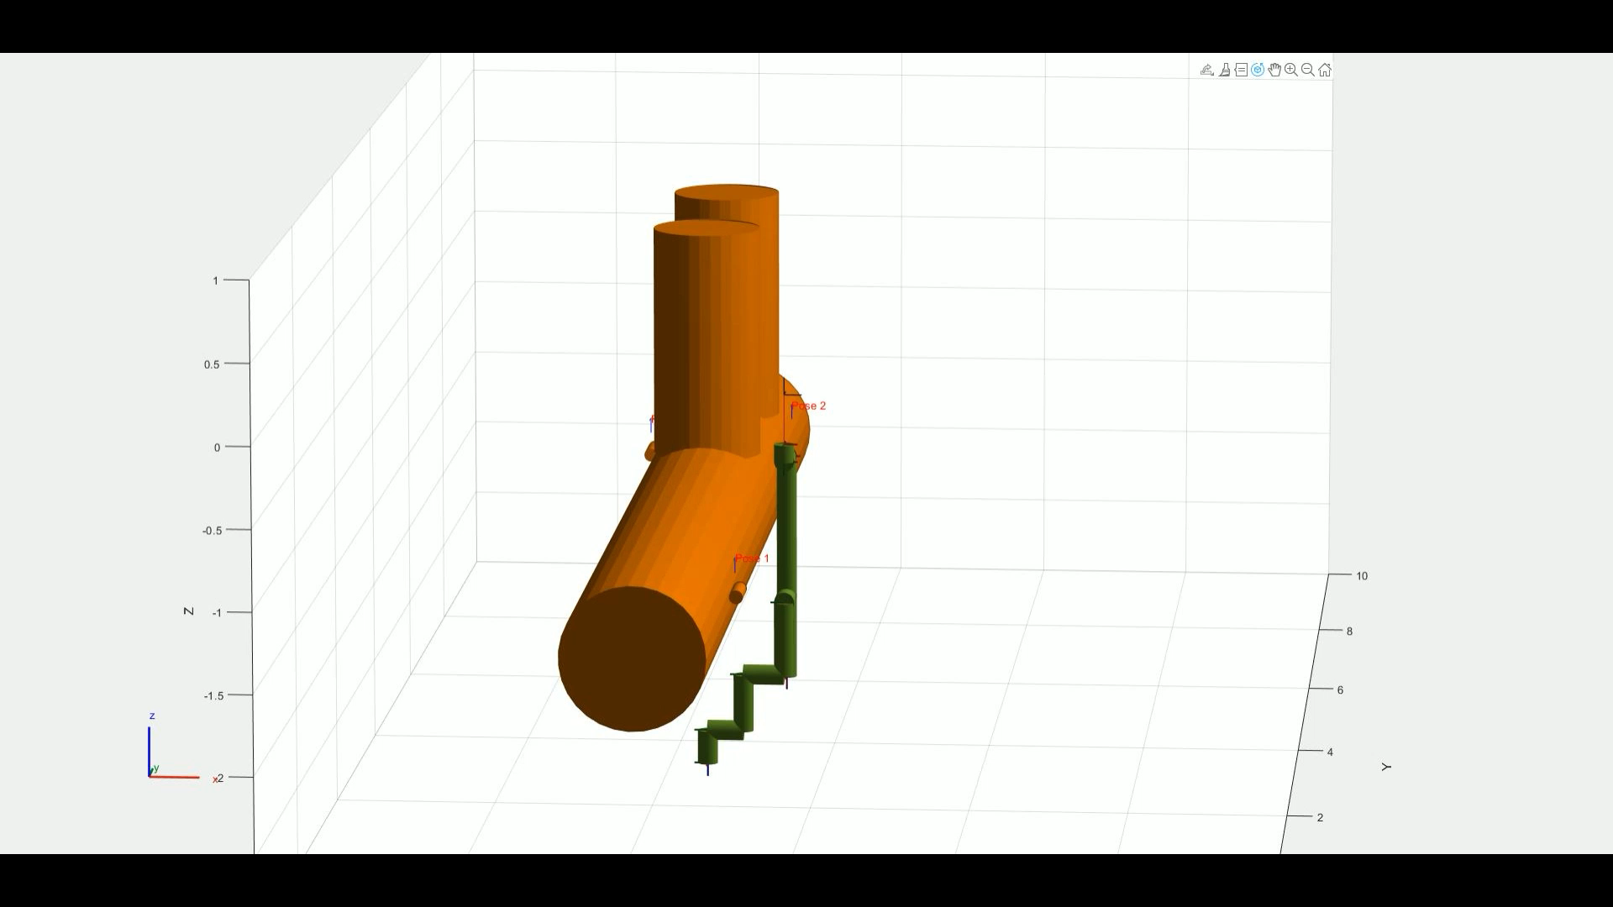
Results

Slide 9
Future Work
Implement final constraint: Foldability
Optimization parameter tuning
Evaluate results for other kinematic structures(4 DOF)
Manufacture & test prototype

Slide 10


Conclusion & Final Thoughts
Is it possible to design a modular robotic arm to meet the specific challenges of the LHC tunnel, eliminating the need for external solutions and without compromising the efficiency of the TIM system?
Is it possible/beneficial to create a modular design for this system?
Is it possible to remove degrees of freedom (DOF) from the design and not lose functionality, thus making the arm lighter?
How do you adequately measure the performance of a robot arm?
Reachability, collision avoidance, accuracy
In the limited time span of this assignment, is it possible to manufacture a completed prototype or should the focus be on formulating a proof of concept (POC)?

